Slide 1
Workforce Update
JHOSC
The JHOSC are asked to:
    Note recent successes
    Note the performance changes specifically in absence and turnover trends and the mitigating actions being put in place through People Plan initiatives and locally across organisations to address them
    Note People Plan 6 key areas and specific achievements and progress
    Support the collaborative approach for creation of the ICS values and behaviours framework as it develops
    Note the 10 people functions for the ICS and progress made in transitioning to an ICS people function
    Support the development and resourcing of a workforce programme for primary care and social care
Charlotte Bailey | 14 December 2021

Slide 2
Contents
Current workforce performance and trends (Core KPIs)
People Plan Progress: quarterly achievements against milestones
People Plan: what’s next and longer term objectives
Transition to the ICS people function: progress update

Slide 3
Current Workforce Performance and Trends
A NWL dashboard of workforce KPIs is being matured. We collect data where it is comparable across organisations. This is core workforce data to help us understand key system trends.

Slide 4
Performance: Core Workforce KPIs

Slide 5
Performance Trends
Our total Provider workforce was 56,513.42 WTE at the end of Q2
Overall staffing WTE planned changes between H1 out-turn (end of Q2) and H2 out-turn (end of Q4) of an additional 1,009 WTE, split as;
Increase of 1,046 WTE substantive staff
  International nursing and midwifery recruitment
  Pipeline and planned recruitment activities
  IAPT, CAMHS and Perinatal Service expansions
  Elective recovery and Elective Care Unit (colorectal services)
  Critical Care provision
  ED Mental Health Assessment Unit
Increase of 99 WTE bank staff
  Support for additional planned H2 activity
Decrease of 135 agency staff
  Cessation of agency staffing as a result of substantive recruitment.

Slide 6
Performance Trends
At the end of August 2021 there were a total of 5,893 WTE vacancies across NWL Trust, a vacancy rate of 11.4%; no change from the previous month.
Voluntary turnover has seen a small but steady increase since the position in April 2021 with a rate of 12.4% at the end of August 2021. This is an area of concern and CPOs are undertaking a deep dive in mid-November to understand patterns and trends and develop mitigating action.
All trusts have model employer targets (diversity within staffing); currently the work is being conducted at an organisational level. We are setting up a group with organisational leads:
  to review organisational trajectories, plans and progress
  look at trends across organisations and best practice that can be shared
  collectively agree an overall ICS-wide target with organisational trajectories, which will drive collective action towards the reduced timescale to achieve the national goals
Core skills compliance remains good with an increasing trend reported since the end of May 2021; current compliance is 91.9%.
Sickness absence has increased month on month since June 2021 with 4.4% reported during the month of August 2021. Despite the monthly rise in sickness absence, the rolling 12-month position is holding steady due to lower levels recorded at various times over the past year. CPO are monitoring trends, developing winter plans and ensuring staff are taking leave.
The most common reasons for sickness absence from work are on slide 8.
The joint NWL Keeping Well Service has had 1,948 referrals since June 2020 and of those receiving an IAPT intervention, 62% have recovered – higher than the 50% norm. September referrals were 147.
Where the presenting problem is known, the majority of referrals have cited depression (38%) or Generalised Anxiety Disorder (31%). PTSD (5%). (More information is in Appendix 1)
Further detail is in appendix 1

Slide 7
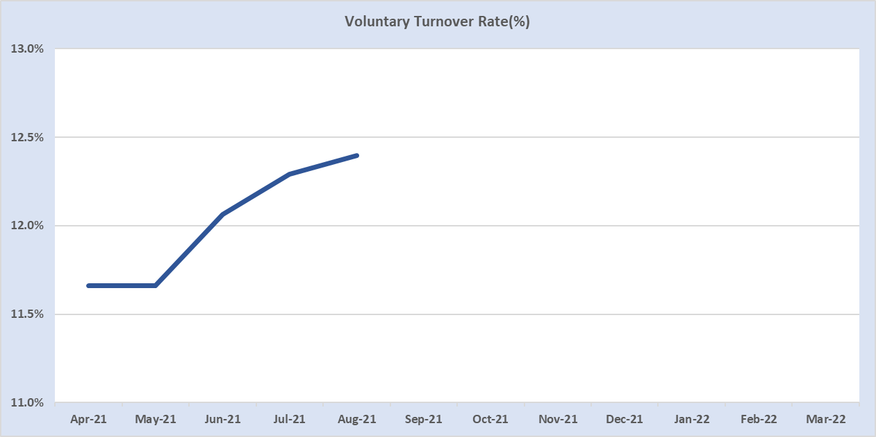
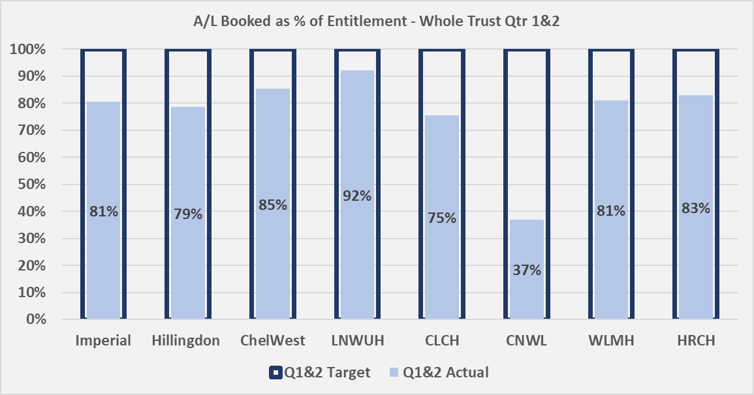
Underlying reasons for performance that requires improvement
Small but steady increase in voluntary turnover seen month on month since May 2021.
We are currently working with Trusts to understand the main drivers to this rise but anecdotal evidence is pointing to an increasing number of clinical staff re-thinking their area of work following the pressures and stresses of the past 18 months; Covid-19 response, elective recovery and increased A&E attendances and admissions.
Evidence is also emerging that turnover amongst the Allied Health Professional staffing group, which already has an established high turnover rate, is also increasing. Of particular concern are Occupational Therapists where there is a national shortage of staff.
Well-being support for staff is a key enabler in reducing turnover and monitoring of annual leave uptake across the Trusts is ongoing to ensure all staff have the opportunity to rest.

Slide 8
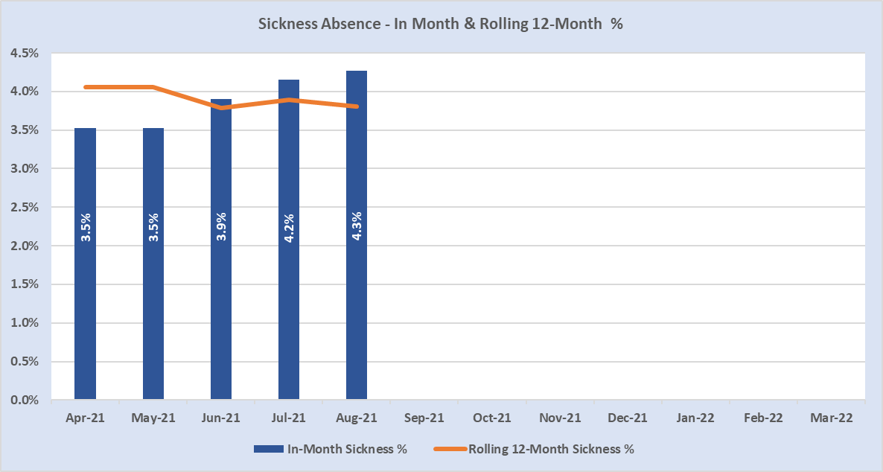
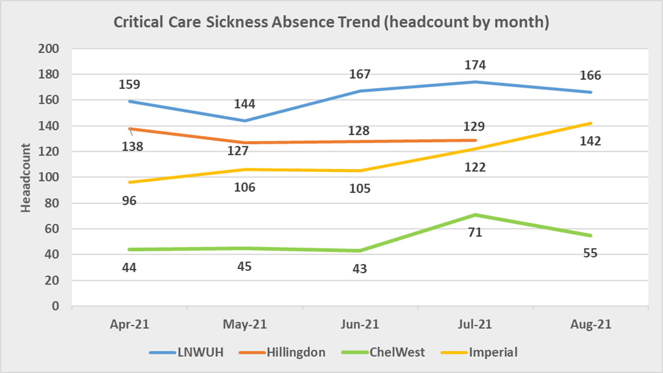
Underlying reasons for performance that requires improvement
Increasing trend in sickness absence seen each month since May 2021. Driving factors;
i) increased levels of Covid related absence
ii) increased levels of cough/cold/flu type illness
iii) increased levels of gastrointestinal type illness
Increasing numbers of staff absent through self-referred sickness such as gastrointestinal illness along with coughs colds & flu and headache/migraine are strong indicators of increased fatigue and stress within the workforce.
A deep-dive into sickness absence within Critical Care services across the sector also showed increased levels of sickness absence since May 2021 correlating to the reasons stated above as well as increased levels of anxiety/stress/depression/other psychiatric illness and headache/migraine.

Slide 9
People Plan: Quarterly Achievements against milestones
The NWL People Plan was refreshed in June 2021 and the short term priorities and flagship work projects as a system were agreed via the People Board, ICS Exec and ICS Partnership; the longer term strategic workforce pieces can still be developed and modified by system partners, it is not fixed. The priorities in the NWL People Plan have been aligned with the national people plan and the current ICS plans.

Slide 10
Current achievements
Awards and recognition: Keeping Well Programme: positive practice recognition in Mental Health award and finalists for BMJ and the HSJ Value awards
Bids and funding: the money we have drawn in by working together is over £2m
Growing OH: national recognition of the NWL programme with an award of funding of £500k to continue and share learning
Leadership Ladder Programme: is one of first to take regional positive action with placements starting 18th October
Compassionate Leadership Programme: first cohort completed the programme in October and is taking learning into their workplace
Mass vaccination and retention programme: NWL is recognised for the success of the mass vaccination programme and is successfully implementing retention plans moving volunteers and programme staff into vacancies across health and social care roles
Collaborative Bank: the medical bank is active and has already supported efficiencies in the region of £219,850 through supporting trusts to access each others staff via the portal

Slide 11
NWL People Plan Progress Update: we are ‘on track’ against the milestones set against current projects
 | On track
 | Delays, recoverable
 | Delayed, mitigation plans in train
NB: Highlight reports for each pillar can be found in Appendix 2
Pillar | Focus / Purpose | Quarterly achievements | RAG | Flagship Project
CARE Nina Singh | To develop a core HWB offer and add value by working together to deliver services | Staff Mental Health Hub – delivering rapid access to IAPT and supported by £470,000 funding Keeping Well academy – providing self-service online resources to staff supported by £338,000 funding ICS HWB Framework – funding allocated to Trusts supporting local HWB initiatives for critical care staff (total £748,000) Occupational Health shared service – supported by £500,000 Growing OH funding; Prototype Business Case complete |  | Delivery of the medium-term framework 10-point plan
LEAD Charlotte Bailey | To support the development of our leaders and managers in core skills | Compassionate Leaders – Cohort 1 complete and next cohorts in planning Organisation Development – ICS Values and Behaviours workshops developed and borough level analysis to shape local OD plans Leadership Ladder programme – Implementation underway which supports BAME staff into senior roles Delivery of new ICS Graduate scheme – updating model to support an ICS approach |  | ICS & System OD plans, Values and Behaviours supporting ICS creation Delivery of the Graduate Schemes
INCLUDE Louella Johnson | To improve our WRES targets and meet our model hospital targets | Inclusive Recruitment – best practice recruitment and selection toolkit developed National MWRES – review completed and best practice case will inform NWL plans Scrutiny Panel – established to act as a ‘critical friend’ to the programme board |  | Leadership Ladder Develop NWL-wide target to meet WRES model employers goal
GROW Sue Smith | To address workforce gaps in priority and hard to recruit roles | Vaccination to Vocation – retention programme underway moving people into permanent health and care roles (161 staff into permanent jobs) NWL Academy – a true partnership approach ensured a strong bid for GLA funding for £250k over 2-years; outcome pending Map educational and apprenticeship pathways – to support employment into the NHS from our local populations in NWL |  | Development of the NWL recruitment and retention strategy
TRANSFORM Kevin Croft | To develop new ways of working that are more effective, efficient and support | Acute Care – workforce transformation programme to support the recovery and sustainability of elective care, critical care, and urgent and emergency care Primary Care – workforce programme to support the PCN recruitment function and expansion of GP/GPN Fellowships Mental Health – workforce transformation programme to support expansion and redesign Medical Staffing – improvement programme |  | Elective care recovery and protection of elective care through winter
ENABLE Claire Gore | To simplify workforce processes and support sustainability and improvement by working together | Collaborative Bank implementation– Medical collaborative bank launched and nursing bank near completion with potential savings identified Workforce information and analytics – development of the Workforce intelligence Service Model agreed with monthly reporting underway Simplifying HR processes and systems – baselining activities underway to identify further opportunities for consolidation |  | Nurse Collaborative Bank to be launched Core HR Admin consolidation to streamline common processes
We are planning to develop more on education and training to support the workforce of the future and will be creating a new pillar – Learn

Slide 12

Primary Care Workforce Update
This is our current baseline and we are conscious of the need to finalise and implement the longer-term strategy that will make a difference in outcomes
Context: Primary Care workforce is under pressure on service provision and a redesign is a fundamental key enabler for improvement. A key driver for change includes the PCN Enhanced Service (DES) where roles such as the Additional Reimbursable Roles Scheme (ARRS) were introduced to support delivery of additional activity outlined in the primary care contract and NWL ICS development; this has prompted further debate on Local Care and place-based workforce activity.
ARRS Activity:
Intention to recruit 90 ARRS through 2021/22; a review is underway to analyse the impact of the roles and the support provided to them
Risks and Challenges:
Recruitment: a ‘tight’ job market and low pre-registration placements mean challenges to achieve desired targets
MH Practitioner ARRS: difficult to recruit but engagement activities indicate increased applications with interviews underway
Paramedics: difficult to recruit - working with LAS to recruit band 6 rotational posts; a peer support pilot with 8 paramedics is underway
Next Steps for the transformation plan:
Analysis of the recruitment intent to assess where additional support may be required for recruitment of the ARRS roles
Exploring recruitment events with ICS partners and rotational development posts
PCN workforce plans analysis to ensure ARRS funding has been fully allocated for 2020-21
GP & GPN Activity:
Analysis of latest data December 2020 – June 2021 shows an increase in GPs by 1.02% and a decrease of GPNs by 11%; if left, GPN numbers will decline by >40% in the next 5-years *
Detailed analysis is underway and preliminary data indicates NWL vacancies is consistent with other London systems but flagged a amber
Mitigation includes: support to newly qualified GP’s and GPN’s via the NHSE Fellowship initiative; GP mentorship scheme with 13 mentoring agreements in place; using patient satisfaction reports to triangulate impact on service delivery against the GP and GPN numbers per head of population
Risks and Challenges: funding for support roles is ‘at risk’ for key support roles (i.e. SPIN Director role reduced to two session per week; GP Clinical Mentorship Lead role is currently vacant and out to advert
Next steps for the transformation plan:
Ensure the GP and GPN SPIN Fellowship and mentoring scheme are continued and supported by NWL
Scope the NWL training practice information in light of the Under Doctored Area data to identify priority areas
Develop clear data to support the impact of a reduced GP and GPN workforce in light of service delivery
Develop a network of Clinical supervisors to support the NWL GP and GPN workforce
*NB: Accurate and consistent data capture and reporting remains an issue in Primary Care; plans to address this are part of the ICS Workforce Dashboard development

Slide 13
A summary of next steps for Primary Care workforce plans
Workforce Data Develop core workforce data standards across the NWL ICS to ensure Primary Care Workforce data is comparable to partner organisations and incorporated into workforce planning | Workforce Planning Support NWL PCN’s to explore workforce in light of their population needs, including GP and GPN needs over the next 2-5 years. available ARRS funding to maximise allocation of ARRS roles | ARRS Work with PCN’s to utilise all their ARRS allocations based on their population health needs ensuring full utilisation of funding by year end | ICS Integration Ensure Primary Care is fully embedded in the ICS development and the NWL People Function
Work with the NWL Business Intelligence Team to scope all available data In collaboration with the NWL ICS Workforce Intelligence Network ensure that the primary care data is comparable to the wider ICS partners looking at commonalities and variations in programme delivery | Build the workforce discussion into all NWL Primary Care work streams moving forward to ensure the workforce training and development discussion is part of all programmes including: Primary Care summit's SOM’s Capacity and Demand Activity PCN Development | Analysis of roles intended for recruitment to build in support resources including collaboration with ICS partner organisations looking at potential: Joint development roles in integrated teams Wider ICS recruitment activity Development of supervision support networks to embed these new roles in primary care | Ensure NWL Primary Care Teams have access to the resources and support available within the wider ICS system including: ICS recruitment events Joint working to develop the NWL Anchor Institute perspective Development of ICS wide pre- registration placement and curriculum development

Slide 14
People Plan what’s next and longer term objectives
We are developing a high-level plan on a page and there are detailed plans emerging with milestones and timescales. Our plan is divided into:
Operational (immediate – less than one year and what we need to do to address here and now workforce priorities)
Tactical (medium term – what people need in the coming year, conducted within the annual budget process, smaller scale priorities)
Strategic (longer term – 2-5 years and what is required to delivery against longer term business strategies; integrated and focused on workforce planning)
We are working to understand the critical roles and services where we have high vacancy or turnover rates (i.e. hard to recruit/ hard to retain) and develop workforce transformation plans against these. This will form part of the tactical and strategic plans.
We continue to integrate plans across health organisations and primary care and have a longer-term approach for incorporating Social Care into those plans

Slide 15
People Plan on a Page: next steps and future initiatives
As we implement our plans we will meet with our partners to align approaches with Social Care and Local Authorities; a Social Care representative is being invited to become a member of the NWL People Board
Pillar | Operational (immediate – less than one year and what we need to do to address here and now workforce priorities) | Tactical (medium term – what people need in the coming year, conducted within the annual budget process, smaller scale priorities) | Strategic (longer term – 2-5 years and what is required to delivery against longer term business strategies; integrated and focused on workforce planning)
CARE Nina Singh | Organisational plans developed for the Delivery of the 10 point plan All organisations implement Pulse Survey | Delivery of the 10 point plan across ICS Development of long-term strategic ICS HWB framework Integration of Primary Care into plans | Integration of social care into plans
LEAD Charlotte Bailey | ICS values and behaviours framework developed Compassionate leadership approach roll out | ICS wide deployment of 2022 Graduate Management Trainee Scheme agreed and in place Management development programme in place supporting ICS talent management approach | Enhances leadership development programme integrated into ICS-wide succession planning process
INCLUDE Louella Johnson | Develop a NWL-wide target to meet WRES Model employers goal trajectories Implement of the NWL Inclusive Recruitment Guide | ‘Insight’ programme to support the development of BAME NEDS, incorporating learning from organisations | Tbc
GROW Sue Smith | Vaccination to vocation programme complete Hard to recruit roles identified with plans to address requirements | ICS-wide apprenticeship provision in place Map educational and apprenticeship pathways that support entry to post graduate level employment into the NHS from the NWL population | Place-based NHS recruitment model addressing underrepresented groups in NWL and opportunities for development / career progression
TRANSFORM Kevin Croft | Recruitment against ARRS roles Maximise workforce agility for winter plans Joint strategies for increasing staff mobility and enhanced use of MOU to enable a more flexible workforce | ARRS roles development against longer term Primary Care workforce strategy Integration of workforce agenda with Primary Care, including transformation, training and education Creation and development of workforce plans for Elective Care, UEC and Critical Care | Long term acute group model and local care transformation Collaborative recruitment strategies and vacancy reduction plans, including new routes into the professions
ENABLE Claire Gore | Implement nursing collaborative bank across Acute Trusts Baseline core HR Administration functions to develop Level 2 end to end processes | E-rostering adopted across all Acute Trusts Expansion of collaborative bank to all organisations and professional groups | Tbc
LEARN Tbc | Establish the pillar priorities and resource to deliver Alignment of competency frameworks – national and local to inform required initiatives and plans for upskilling staff | CPD programmes and technology enhanced learning resources ICS Management development programme supporting new and existing managers | Tbc

Slide 16
Transition to the ICS people function – progress update
We have developed a plan to meet the requirements outlined in the People Function ICS Guidance.
A HRD working session will be scheduled for early December to work through the requirements and assess the readiness and capability of the People Function.

Slide 17

ICS People Function 4 preparatory actions are underway and to be completed by the end of March 2021/22 to support delivery of 10 people functions
No. | Action | Notes | Progress
1. | Agree the formal ICB and ICP governance and accountability arrangements for people and workforce in the ICS, including appointed SROs. | Roles are identified and due to be appointed to. Governance arrangements are being developed.
2. | Agree how and where specific people functions are delivered within the ICS (for example, ICB, provider collaborative, place-based partnership). | Plans for each people function/pillar are in development which will determine where delivery will take place.
3. | Review and refresh the current ICS People Board (or establish where not already in place) in line with wider ICS governance and accountabilities and with clear reporting arrangements into the ICS Board. | People Board refreshed in line with NWL People Plan and ICS governance arrangements agreed.
4. | Assess the ICS’s readiness, capacity and capability to deliver the people function (for example, using resources already available such as the System Development Progression Tool), including identifying gaps and initiating a plan for developing the necessary infrastructure across the totality of the ICS. | Some milestones underway. Additional milestones and plan to be agreed in line with overall ICS readiness programme plan.
✓

Slide 18
Preparing to transition to the ICS People Function
Note: additional information is provided in Appendix 3
ICS People Functions | Our Current NWL People Plan is aligned to the ICS People Function
 | Care | Include | Lead | Transform | Grow | Enable | Learn
Supporting the health and wellbeing of staff | ✓
Growing the workforce for the future and enabling adequate workforce supply |  |  |  |  | ✓
Supporting inclusion and belonging for all, and creating a great experience for staff |  | ✓
Valuing and supporting leadership at all levels, and lifelong learning |  |  | ✓ |  |  |  | ✓
Leading workforce transformation and new ways of working |  |  |  | ✓
Educating, training and developing people, and managing talent |  |  |  | ✓ | ✓ |  | ✓
Driving and supporting broader social and economic development |  |  |  |  | ✓
Transforming people services and supporting the people profession |  |  |  |  |  | ✓
Leading coordinated workforce planning using analysis and intelligence |  |  |  | ✓
Supporting system design and development |  |  | ✓
Current state of readiness
People Plan programmes have been mapped to the 10 outcomes and we continue to make progress with implementation
Full and detailed project plans are in place to complete:
  Process for deliver of people functions
  Delivery arrangements
  Governance and accountability (see appendix)
  How and where specific people functions will be delivered within the ICS
  Refresh the People Board
  Readiness assessments
  ICS culture plans
Progress reporting
Monitored through HRD and People Board meetings and reporting quarterly to Partnership Board
ICS Organisation Development
Values and behaviours framework development plans are in train (see next slide)

Slide 19
Developing the ICS Workforce Update
A series of workshops are in development to co-design the framework engaging both employees and partners
An ‘appreciative enquiry’ approach will ensure preservation of what works well now and what might/should/will work well in the new ICS
Aim for approx. 200 participants in 8 workshops commencing end October to end December
Additional feedback forums will be introduced to widen participation and engagement during and after this period
A dedicated workshop for ICS Execs and Partnership Board members is planned following completion of the workshops
Why we are taking this approach
Engaging across a wide set of stakeholders to co-create a framework that describes shared ways of working and behaviours will ensure that all parts of the ICS, at system, borough and employee levels know what is expected of them and each other and will have contributed to shaping how this will be delivered
Substantial engagement and involvement will help move people along the change curve from ‘awareness’ to ‘commitment’ and build trust over time. This cannot be achieved from introducing a new governance structure and statute alone
We are taking action to address the risk of ‘new acronyms but old ways of working’ to ensure staff deliver to their full potential and, as an ICS, we continue to build our reputation based on how we act on what we are committed to delivering
Once developed, the framework will be hardwired into ICS structure, systems and processes to support all staff with leaders acting as visible role models

Slide 20
Next steps and support required from ICS Partnership
ICS Partnership Board is asked to
  Note recent successes
  Note the performance changes specifically in absence and turnover trends and the mitigating actions being put in place through People Plan initiatives and locally across organisations to address them
  Note People Plan 6 key areas and specific achievements and progress
  Proactively support the collaborative approach for creation of the ICS values and behaviours framework as it develops
  Note the 10 people functions for the ICS and progress made in transitioning to an ICS people function
  Support the development and resourcing of a workforce programme for primary care and social care

Slide 21
Appendices

Slide 22
Appendix 1: NWL People Performance

Slide 23
Indicator | Target | (April) | (May) | (June) | (July) | (August)
Establishment Post WTE | - | 50,320.2 | 50,365.4 | 50,538.2 | 50,869 | 51,489
Staff InPost WTE | - | 45,161.9 | 45,145.4 | 45,175.6 | 45,066 | 45,596
Vacant WTE | - | 5,158.3 | 5,220.0 | 5,362.6 | 5,803 | 5,893
Staff InPost Headcount | - | 49,815 | 49,847 | 49,838 | 49,606 | 50,118
Vacancy Rate % | 8% - 12% | 10.3% | 10.4% | 10.6% | 11.4% | 11.4%
In-Month 2021 Sickness % | 3.3% - 4.4% | 3.5% | 3.5% | 3.9% | 4.2% | 4.3%
Rolling 12-Month Sickness % | 3.3% - 4.4% | 4.1% | 4.1% | 3.8% | 3.9% | 3.8%
Voluntary Turnover Rate % | 10% - 18.4% | 11.7% | 11.7% | 12.1% | 12.3% | 12.4%
Core Skills Compliance % | 85% - 92% | 88.7% | 88.7% | 90.6% | 90.2% | 91.9%
Workforce Summary
Target Performance:
Currently all 8 Trusts have their own workforce KPI targets and work has commenced with the sector HRDs to look at setting and agreeing sector-wide targets for core workforce KPIs
Current Month’s Achievement:
Trusts overall vacancy rate at 11.4%; no change from the previous month
Establishment up by 620 WTE and staff by 530 WTE; TUPE transfer into CLCH
Core skills overall compliance remains good at 91.9%
Plans to Mitigate Performance:
Voluntary turnover has seen a small but steady increase since the position in April 2021 with a rate of 12.4% at the end of August 2021.
See workforce slide 2 for drivers and mitigations
Sickness absence has increased month on month since June 2021 with 4.4% reported during the month of August 2021.
targets for these measures
Note - targets and RAG rating still to be developed
Data Source:
ICS Dashboard

Slide 24

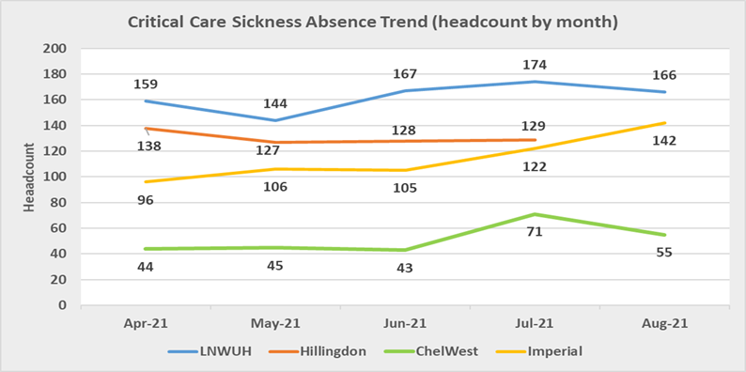
Seen establishment growth of 331 WTE with 37% attributable to an increase at WLHNT
Workforce Sickness Absence
Increasing trend in sickness absence seen each month since May 2021. Driving factors;
i) increased levels of Covid related absence
ii) increased levels of cough/cold/flu type illness
iii) increased levels of gastrointestinal type illness
Increasing numbers of staff absent through self-referred sickness such as gastrointestinal illness along with coughs colds & flu and headache/migraine are strong indicators of increased fatigue and stress within the workforce
A deep-dive into sickness absence within Critical Care services across the sector also showed increased levels of sickness absence since May 2021 correlating to the reasons stated above as well as increased levels of anxiety/stress/depression/other psychiatric illness and headache/migraine
Trend analysis of long and short term sickness absence is underway to ascertain the make up of sickness episodes, reasons for absence and hot-spot areas for focus
Data Source:
Workforce Dashboard

Slide 25
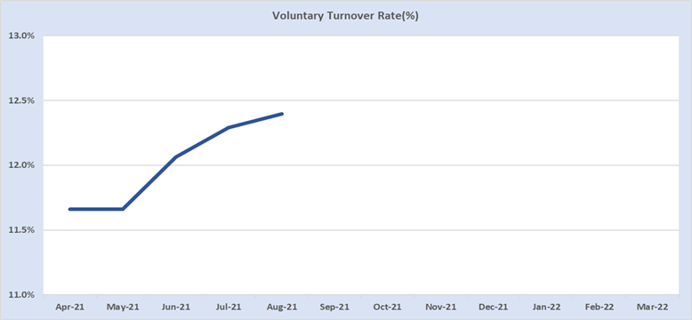

Seen establishment growth of 331 WTE with 37% attributable to an increase at WLHNT
Workforce Voluntary Turnover
Small but steady increase in voluntary turnover seen month on month since May 2021.
We are currently working with Trusts to understand the main drivers to this rise but anecdotal evidence is pointing to an increasing number of clinical staff re-thinking their area of work following the pressures and stresses of the past 18 months; Covid-19 response, elective recovery and increased A&E attendances and admissions
Evidence is also emerging that turnover amongst the Allied Health Professional staffing group, which already has an established high turnover rate, is also increasing. Of particular concern are Occupational Therapists where there is a national shortage of staff
Well-being support for staff is a key enabler in reducing turnover and monitoring of annual leave uptake across the Trusts is ongoing to ensure all staff have the opportunity to rest
Data Source:
Workforce Dashboard

Slide 26
Appendix 2: NWL People Plan Highlight Reports

Slide 27
CARE: We have a healthy and engaged workforce
Focus | Area | RAG | Area | RAG
Outcome: Access to psychological support for individual and team wellbeing Legacy: A workforce that feels that NWL employers understand their needs Impact: A workforce that has increased resilience and loyalty to NWL employers | Are we on track to deliver? |  | Resources in place
 | Risks |  | Governance in place
What has been achieved so far
Staff Mental Health Hub - £470,000 funding is supporting psychological support for ITU/Critical Care staff and staff supporting Covid-19 response Outreach to Primary and Social Care via the Keeping Well academy - £338,000 funding to curate a digital library of research and guidance, including strategies to maintain and support staff wellbeing and training resources within the system ICS Health and Wellbeing Framework In-reach with NHS Trusts - £748,000 allocations to each Trust based on a weighted framework that enables development of infrastructures where needed; allocations will also be used to implement the ICS H&WB Framework for 2021-22 and develop a 3 year H&WB Strategy for 2022-25 Occupational Health shared service - £500,000 Growing OH funding secured to support the creation of NWL OH services
What comes next
Establish committed actions from Trusts within the medium-term framework to consider: Implementation of ‘pulse checks’ Mental health first aider training Team check-ins Multi-disciplinary learning events Dedicated support sessions for staff in high impact areas Wellbeing Guardians Review national H&W framework longer term strategy to inform/align mid- to longer term plans

Slide 28
LEAD: We care and staff report positive experiences
Focus | Area | RAG | Area | RAG
Outcome: Improved career opportunities and increased job satisfaction Legacy: A compassionate, kind and inclusive culture Impact: A workforce that is the best they can be to deliver health and care services | Are we on track to deliver? |  | Resources in place
 | Risks |  | Governance in place
What has been achieved so far
Compassionate Leaders – Cohort 1 is completing (started 18th May) with further cohorts in development and utilising HWB funding of £740,000 (see Care update) Organisation Development – agreement to develop ICS Values and Behaviours framework supporting transition to the ICS and new ways of working; established ICS OD leads network and held early planning meetings to support ICP Directors in developing local plans Leadership Ladder programme – programme ready for implementation supporting BAME staff in senior roles; offers development secondments/placements across Band 8a-c roles (Linked with Include)
What comes next
Compassionate Leaders: confirm plans for the next programme for Cohorts 2 & 3 Run Values and Behaviours workshops and co-design the framework and develop additional engagement plans to ‘hardwire’ behaviours into ways of working Work with ICP Directors to develop OP plans supporting establishment of place-based teams Leadership Ladder programme go-live 18th October (with Include) Establish the ICS Graduate Scheme working with local Universities and supporting local talent into roles within NWL and link with the national GMTS scheme to develop a NWL rotation.

Slide 29
INCLUDE: We are inclusive and succeed because of our differences
Focus | Area | RAG | Area | RAG
Outcome: Embedded diverse and inclusive workforce Legacy: Positive action on EDI in design, delivery and review of processes & policies Impact: Inequalities are identified and addressed | Are we on track to deliver? |  | Resources in place
 | Risks |  | Governance in place
What has been achieved so far
Leadership Ladder programme – programme ready for implementation: 12 associates matched to 12 placements Online learning platform developed and available to associates Information packs have been shared with host and substantive managers Associates have met with host managers Preparation for induction, on-boarding and objective setting is underway Secondment agreements are being signed Inclusive Recruitment – develop a best practice SOP for recruitment to ensure people processes are as inclusive as possible enabling organisations to review their processes against the best practice recruitment and selection toolkit National MWRES – review completed and best practice case studies used to inform NWL plans Scrutiny Panel – established to act as a ‘critical friend’ to the programme board
What comes next
Leadership Ladder: First 6mth placements start 18th October Evaluation process underway to identify what worked well and what can be modified for future cohorts Mentors to be agreed across all seven participating organisations Plan and complete rollout of the Inclusive Recruitment Toolkit and work with workforce leads to support implementation of local plans BAME NED development - scope a NW London version of the Insight programme to allow potential NEDS the opportunity to shadow boards, receive induction, attend board and sub-committee meetings and to receive mentoring and support from a non-executive director “buddy”.

Slide 30
GROW: We have the capacity to deliver great care
Focus | Area | RAG | Area | RAG
Outcome: A workforce that is resilient and agile Legacy: Creation of intelligence driven, locally led dynamic workforce planning Impact: Attraction of the best talent by working collaboratively including with universities and colleges and pan-London groups | Are we on track to deliver? |  | Resources in place
 | Risks |  | Governance in place
What has been achieved so far
Appointment of Grow senior programme manager – ensuring plans are developed and delivered Vaccination to Vocation – retention programme in place and moving staff into permanent health and care roles across ICS; 40% of all staff from Vaccination hubs to be placed in roles NWL Academy – a partnership approach ensured a strong bid for GLA funding supporting the NWL health academy was submitted for £250k over 2-years
What comes next
Ongoing retention of vaccination staff including those stood down from Phase 3 vaccination programme NWL Academy – (pending successful bid) detailed plans to be developed and appointment of the Academy co-ordinator Apprenticeship approach for NWL developed and agreed across Trusts Staff Retention project – bid to secure funding for a 1-year programme designing and implementing retention strategies across NWL – diagnostic phase in Q4 Establish governance to ensure partnership working is aligned across initiatives

Slide 31
TRANSFORM: We have the skills to deliver 21st century care
Focus | Area | RAG | Area | RAG
Outcome: A workforce equipped with skills and structures to deliver new clinical models Legacy: An agile workforce using new technologies to deliver outstanding care Impact: New roles and new ways of working supporting new models of care | Are we on track to deliver? |  | Resources in place
 | Risks |  | Governance in place
What has been achieved so far
Acute trust redeployment: plans confirmed Workforce principles: adoption of Elective Recovery workforce principles - NWL and London Skills Passport: Increased uptake of skills passport to support critical care surge Clinical engagement group: set up for medium/longer term approach to critical care sustainability/expansion Digital Passport: agreement to continue the use of the inter-organisational portability agreement pending digital passport set up Managing spend: Agreed approach to contain temporary medical spend Programme Launch: kick off meeting for the Acute and Medical Staffing Transformation Programme
What comes next
Confirm resourcing for the Acute and Medical Staffing Transformation Programme Skill mix & new workforce models for winter and longer term expansion Coordinated approach across acute trusts to the management of bank/agency pay rates and staff incentives Joint strategies for increasing the mobility of staff across organisations and locations, including the utilisation of the digital passport Collaborative recruitment strategies and vacancy reduction plans Review of training capacity across NWL to facilitate CESR Programmes Review of job planning guidance/tariffs across NWL Engage key stakeholders to understand the medical workforce structures and staffing across NWL trusts

Slide 32
ENABLE: We support organisations to make the transition to operate as part of a single system
Focus | Area | RAG | Area | RAG
Outcome: Processes and systems are simplified and consistent across the sector Legacy: A workforce that is equipped to work flexibly across the ICS Impact: Organisations operate as part of a single system | Are we on track to deliver? |  | Resources in place
 | Risks |  | Governance in place
What has been achieved so far
Simplifying HR processes and systems – Medical collaborative bank launched and nursing bank near completion with potential savings identified Workforce information and analytics – development of the Workforce intelligence Service Model agreed with monthly reporting underway Core HR Admin consolidation and collaboration – baselining activities are underway to identify further opportunities for consolidation including SIPS, Process Automation and BOT pilots
What comes next
Launch nursing collaborative bank at end November Continue planned approach to mature workforce information and analytics Confirm additional HR consolidation opportunities, identifying quick wins and options to take forward, developing high level Business Case

Slide 33
Appendix 3: ICS People Function Development

Slide 34
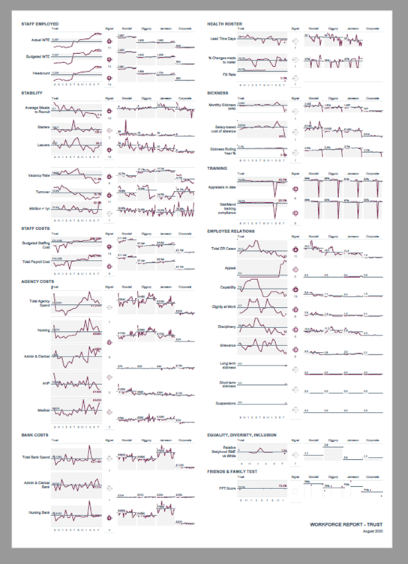
Workforce Governance will be reviewed following readiness of ICS People Function
Current Governance Structure
Quarterly National Returns against ICS People Plan
Regional Returns
Care Partnership
ICS Exex.
Deep Dives
CEO’s
NWL People Board
Claire Murdoch Chair
Education Board ensuring ongoing workforce development
HRD Programme management oversight
Inclusion Board and independent scrutiny of workforce inequalities
HRD Sponsors
Leadership of the collaborative workstreams (20%)
Evolving maturity of the NWL Workforce Dashboard which will improve creation of insights
Trusts
Collective work we all do but in our individual trusts (80%)
Workforce element of SOM

Slide 35
Using the System Development Tool, it outlines key design features which should be in place:
People delivery infrastructure
Phase | ID | Feature | Assessment
Preliminary | 1.1 | The ICS has established a Workforce Improvement Programme Board, and programme leadership, and associated resources have been identified and mobilised
 | 1.2 | The ICS has established arrangements to account for progress and performance in respect of the workforce improvement programme and response to the NHS People Plan to the ICS Board, to place partnerships and to the statutory boards of ICS partners, as appropriate
 | 1.3 | The ICS has a clear understanding of the key workforce challenges that prevail across and within the ICS
 | 1.4 | A system-wide workforce development work programme has been defined and key priorities and timelines identified. This work programme is under way
Foundation | 2.1 | The ICS has strong local people and workforce leadership, with Board level accountability for people across the breadth of the system. People and workforce are prioritised within ICS strategic plans
 | 2.2 | A system-wide ICS People Plan has been developed and is being delivered by the ICS. This Plan describes how the ICS will deliver the people priorities set out in the NHS People Plan and annual planning guidance, as well as its own local people priorities
 | 2.3 | An ICS People Board has been established to oversee the implementation of the ICS People Plan and other local people priorities. The ICS People Board has appropriate powers vested in it that enable it to carry out the functions assigned to it and it includes appropriate clinical, professional and staff representation. The People Board reports directly to the ICS Board
 | 2.4 | The ICS has assessed its current maturity to deliver a full people function against the themes in the system workforce improvement model (SWIM), and has plans with key milestones to develop its capacity and capability to deliver this, as part of wider ICS development plans
Advanced | 3.1 | The ICS’s People Plan continues to be one of the ICS’s principal areas of collective activity. This Plan continues to command the full attention of the ICS Board and is supported by appropriate levels of leadership and resource
 | 3.2 | The ICS NHS Board continues to provide oversight of the ICS’s People Plan. The Plan has been periodically refreshed in light of progress made, as well as emerging local and national people priorities
 | 3.3 | The ICS regularly reviews its progress against the themes in the system workforce improvement model (SWIM) to identify areas for further development in order to deliver local people priorities and a mature people function
 | 3.4 | The ICS has established processes to undertake medium to long-term planning of the system’s ‘one workforce’ in an integrated way across workforce, finance and activity – factoring in future workforce demand, changes in skills and ways of working, service transformation and care delivery requirements

Slide 36
Using the System Development Tool, it outlines key design features which should be in place:
Talent management and development
Phase | ID | Feature | Assessment
Preliminary | 1.1 | There are clear approaches to talent management which include annual career conversations, unbiased recruitment process and identification of talent pools. This is underpinned by consistently understood definitions of potential, talent and readiness criteria
 | 1.2 | Recruitment and onboarding processes are inclusive and values based, aligned to organisational objectives
 | 1.3 | Inclusive talent management is recognised as a strategic priority which is reflected in ICS people plans and with collective accountability embedded within the ICS
 | 1.4 | Organisations routinely collect talent data and have initiated the development of cross-boundary talent data sharing principles. This includes collecting and measuring data around diversity and associated benefits
Foundation | 2.1 | Organisations have a clear transparent inclusive talent management strategy which is incorporated into People Plans and linked to strategic priorities and objectives. This strategy describes the benefits and value of diversity
 | 2.2 | The system has a clear approach to using data to identify and mitigate issues relating to talent management
 | 2.3 | The ICS actively engages with talent by shaping apprenticeships, development intiaitves, mentioring schemes and career transition conversations to support individuals' ability to maximise their potential and the ICS to deliver its objectives
 | 2.4 | There are named organisational Board members responsible for inclusive talent management, with priorities written into strategic/delivery plans, job descriptions and objectives and explicitly role modelled
Advanced | 3.1 | The ICS has an inclusive talent management strategy, linked to strategic priorities and objectives. This strategy is understood by all and delivery of it is seen as everybody's responsibility
 | 3.2 | Data and lived experience are actively used to close the gap on inequalities and address retention issues
 | 3.3 | Talent information is used to design ICS-wide interventions and support mobility through ICS-wide succession planning and engaging staff in talent development opportunities
 | 3.4 | Collective decision making takes into account national perspectives and encompasses organisational, ICS, regional and national landscapes

Slide 37
10 outcomes-based functions
1
Supporting the health and wellbeing of all staff: people working and learning in the ICS feel safe and supported in their physical and mental health and wellbeing, and are therefore better able to provide high-quality, compassionate care to patients.
Growing the workforce for the future and enabling adequate workforce supply: the system is retaining, recruiting and, where required, growing its workforce to meet future need. The ‘one workforce’ across the ICS is representative of the local communities served.
Supporting inclusion and belonging for all, and creating a great experience for staff: people working and learning in the ICS can develop and thrive in a compassionate and inclusive environment. Issues of inequality and inequity are identified and addressed for all people working in the system. The workforce and leaders in the ICS are representative of the diverse population they serve.
Valuing and supporting leadership at all levels, and lifelong learning: leaders at every level live the behaviours and values set out in the People Promise, and make strides so that this is the experience of work for all of their ‘one workforce’.
Leading workforce transformation and new ways of working: service redesign is enabled through new ways of working, which make the most of staff skills, use of technology and wider innovation – to both meet population health needs and drive efficiency and value for money.
Educating, training and developing people, and managing talent: education and training plans and opportunities are aligned and fit for the needs of staff, patients and citizens, including to enable new ways of working and support meaningful and personalised career journeys.
Driving and supporting broader social and economic development: leaders ensure that their organisations leverage their role as anchor institutions and networks to create a vibrant local labour market, promote local social and economic growth in the wider community, support all ICS partners to ‘level up’, address wider health determinants and inequalities at the heart of poor health.
Transforming people services and supporting the people profession: high-quality people services are delivered by a highly skilled people profession to meet the future needs of the ‘one workforce’, enabled by technology infrastructure and digital tools.
Leading coordinated workforce planning using analysis and intelligence: integrated and dynamic workforce, activity and finance planning meets current and future population, service and workforce needs, across programme, pathway and place.
Supporting system design and development: the system uses organisational and cultural system design and development principles to support the establishment and development of the integrated care board (ICB), and the integrated care partnership (ICP). The organisational development approach creates a system-wide culture that: is driven by purpose; enables people, places and the system to fulfil their potential; is connected to the people served by the system and those delivering services; harnesses the best of behavioural, relational and structural approaches; and nurtures collaboration
2
3
4
5
6
7
8
9
10

